Slide 1


Slide 2
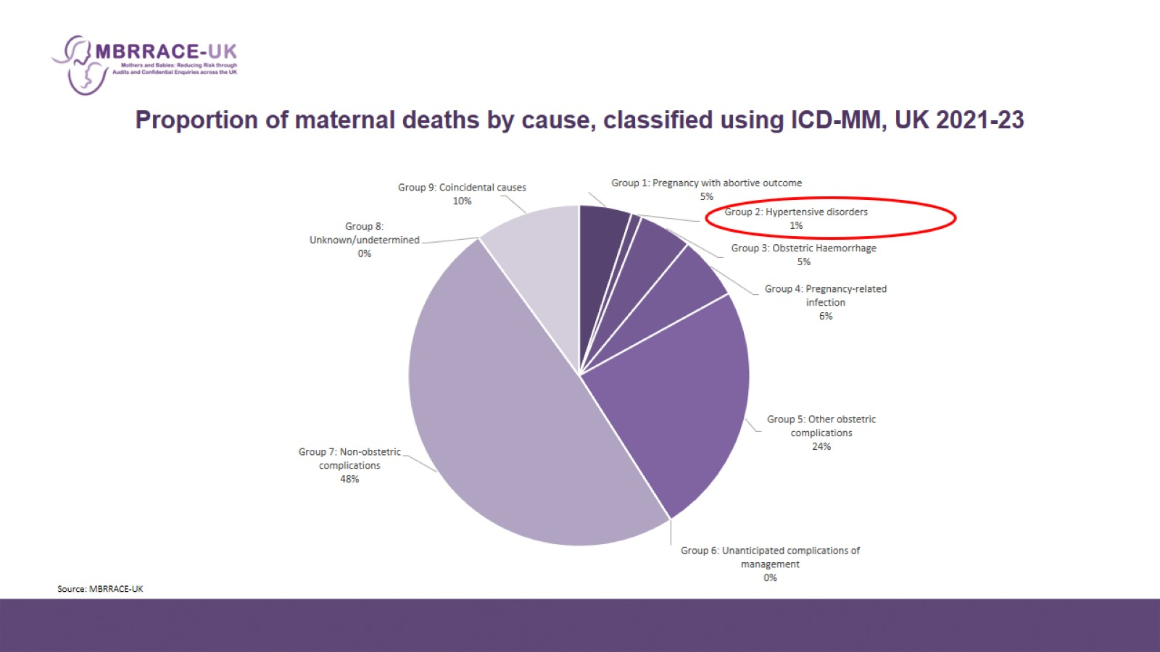
Proportion of maternal deaths by cause, classified using ICD-MM, UK 2021-23

Slide 3
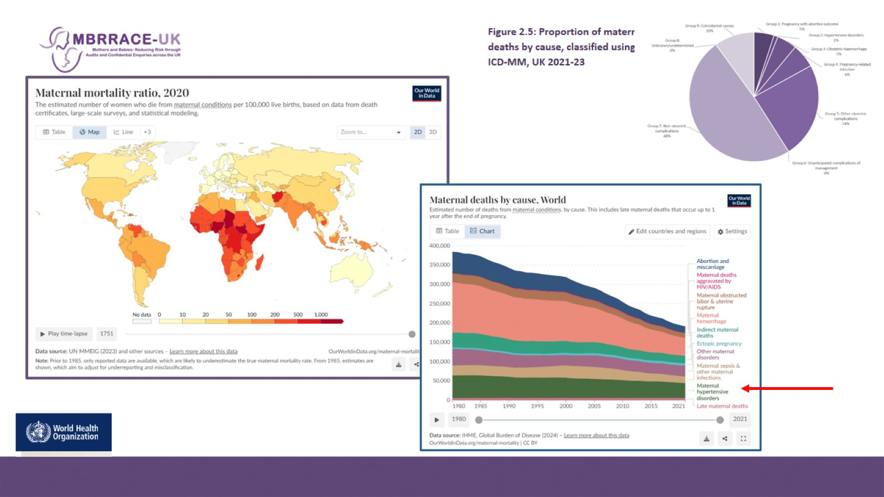
Figure 2.5: Proportion of maternal deaths by cause, classified using ICD-MM, UK 2021-23

Slide 4
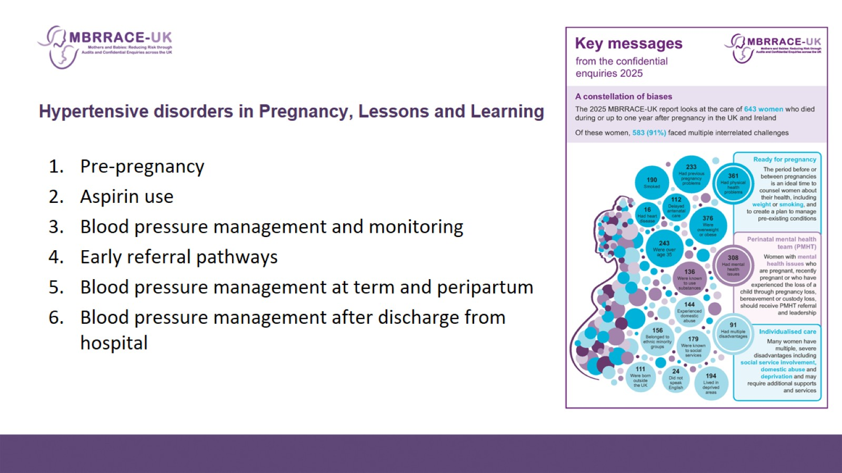
Hypertensive disorders in Pregnancy, Lessons and Learning

Slide 5
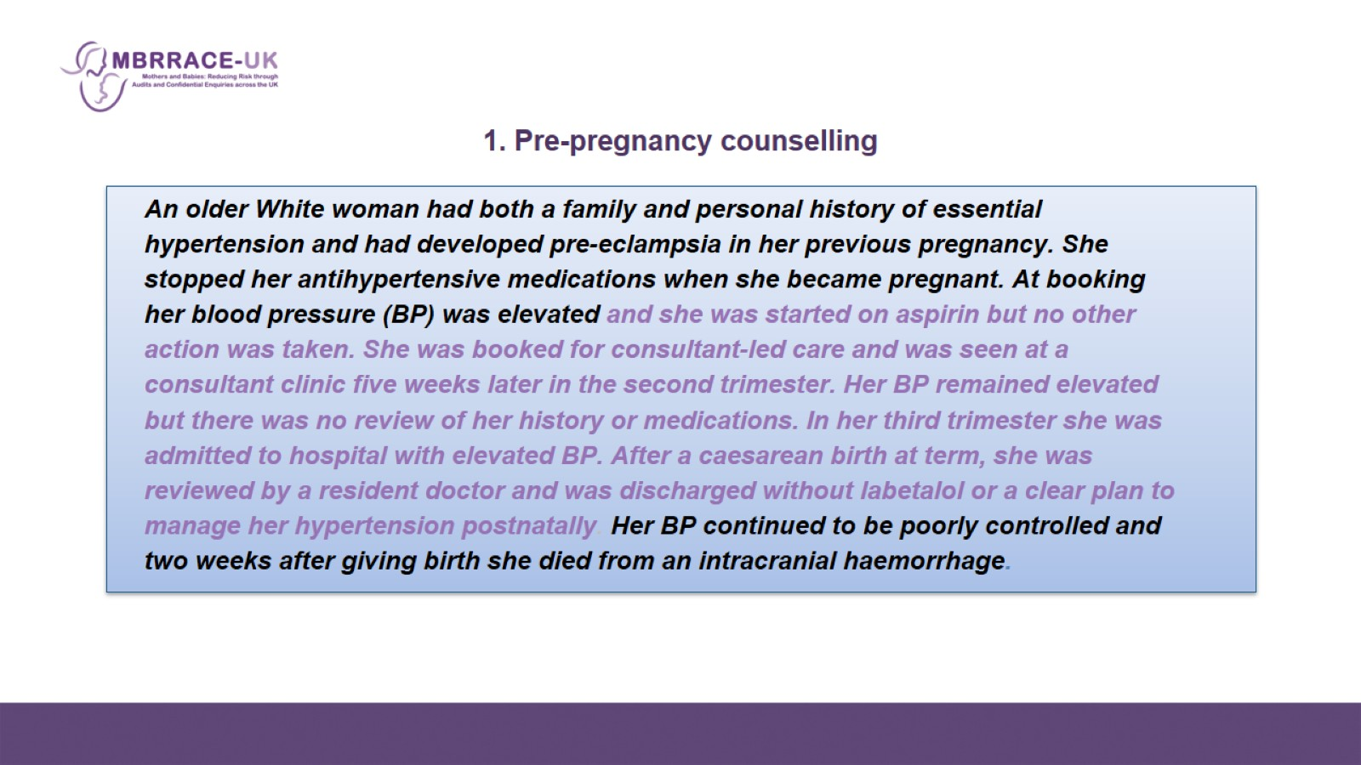
    1. Pre-pregnancy counselling

Slide 6
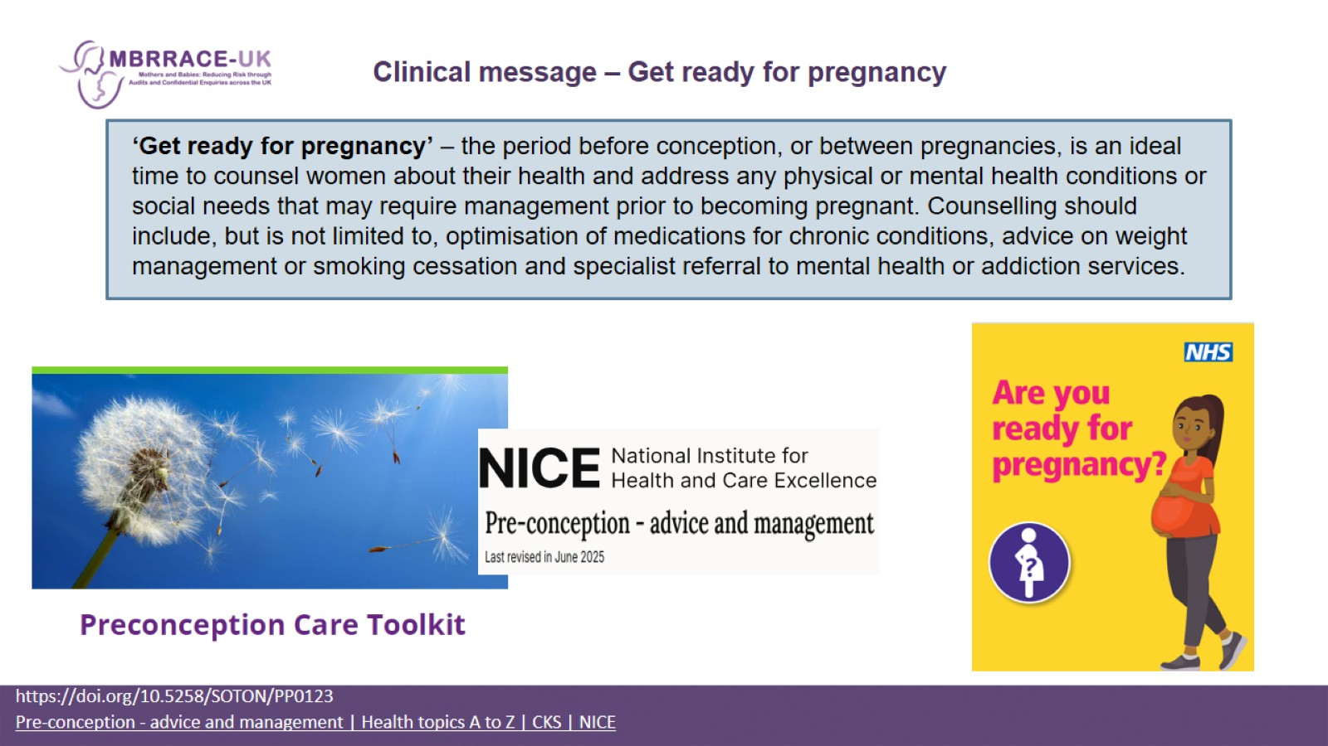
    Clinical message – Get ready for pregnancy

Slide 7
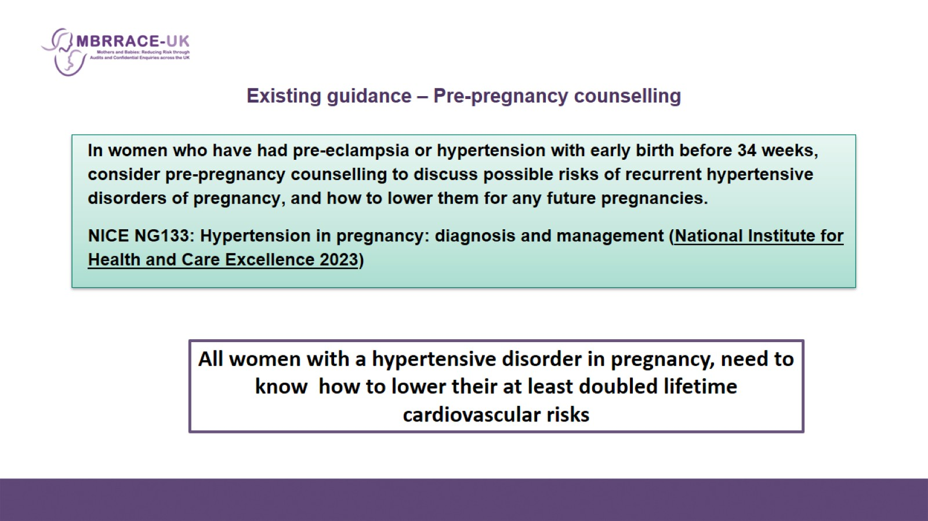
    Existing guidance – Pre-pregnancy counselling

Slide 8
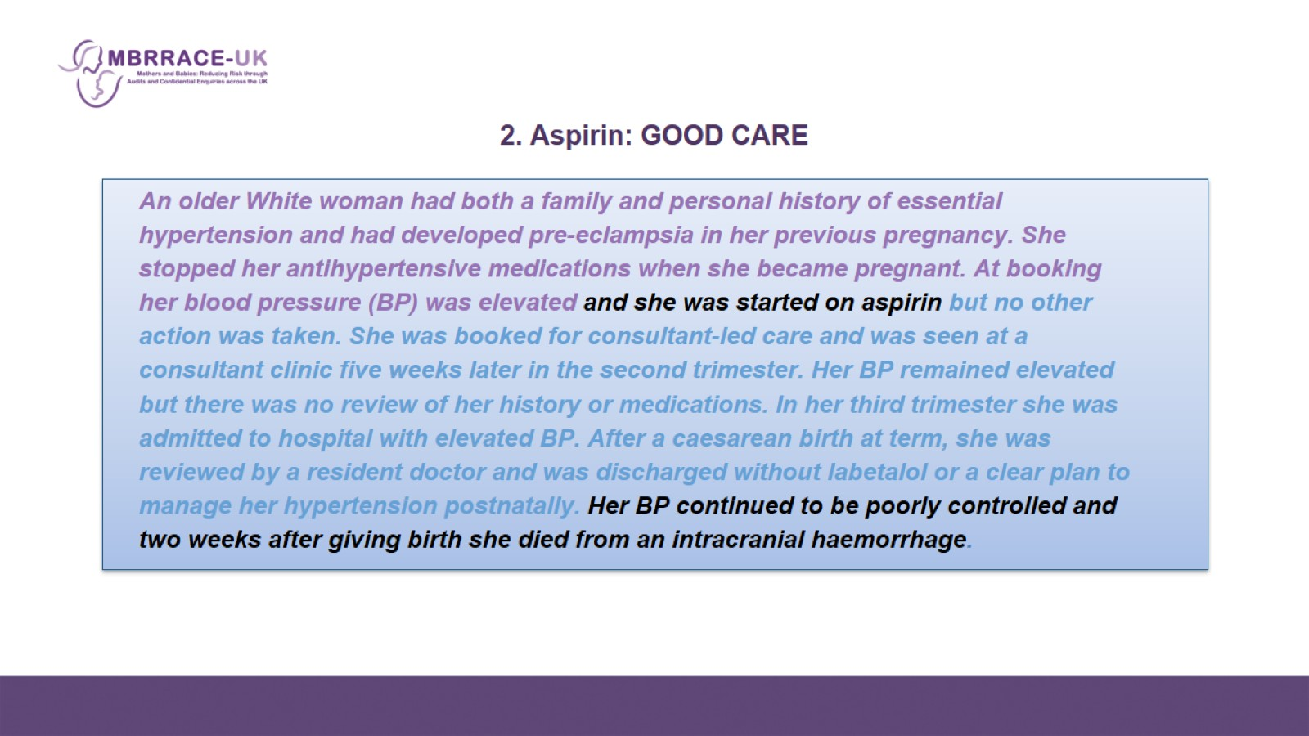
    2. Aspirin: GOOD CARE

Slide 9
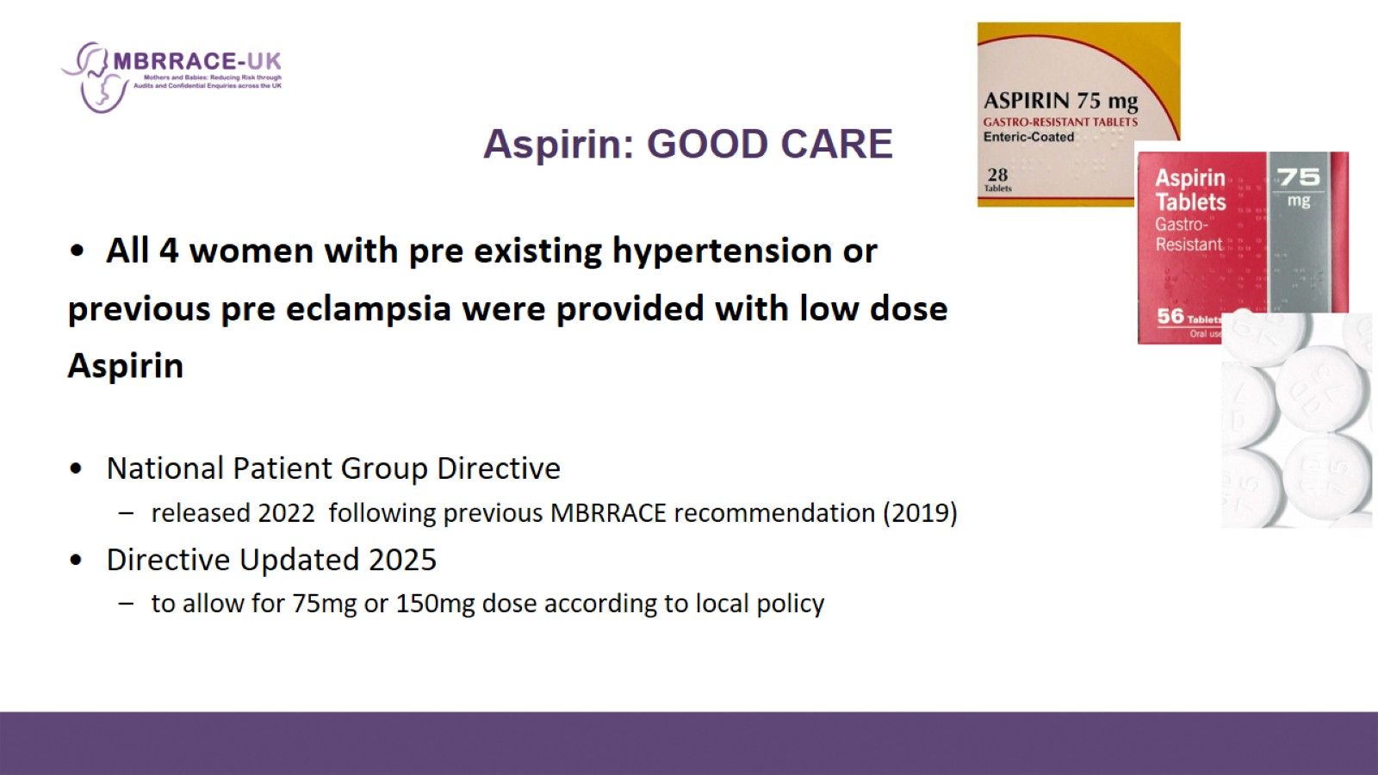
    Aspirin: GOOD CARE

Slide 10
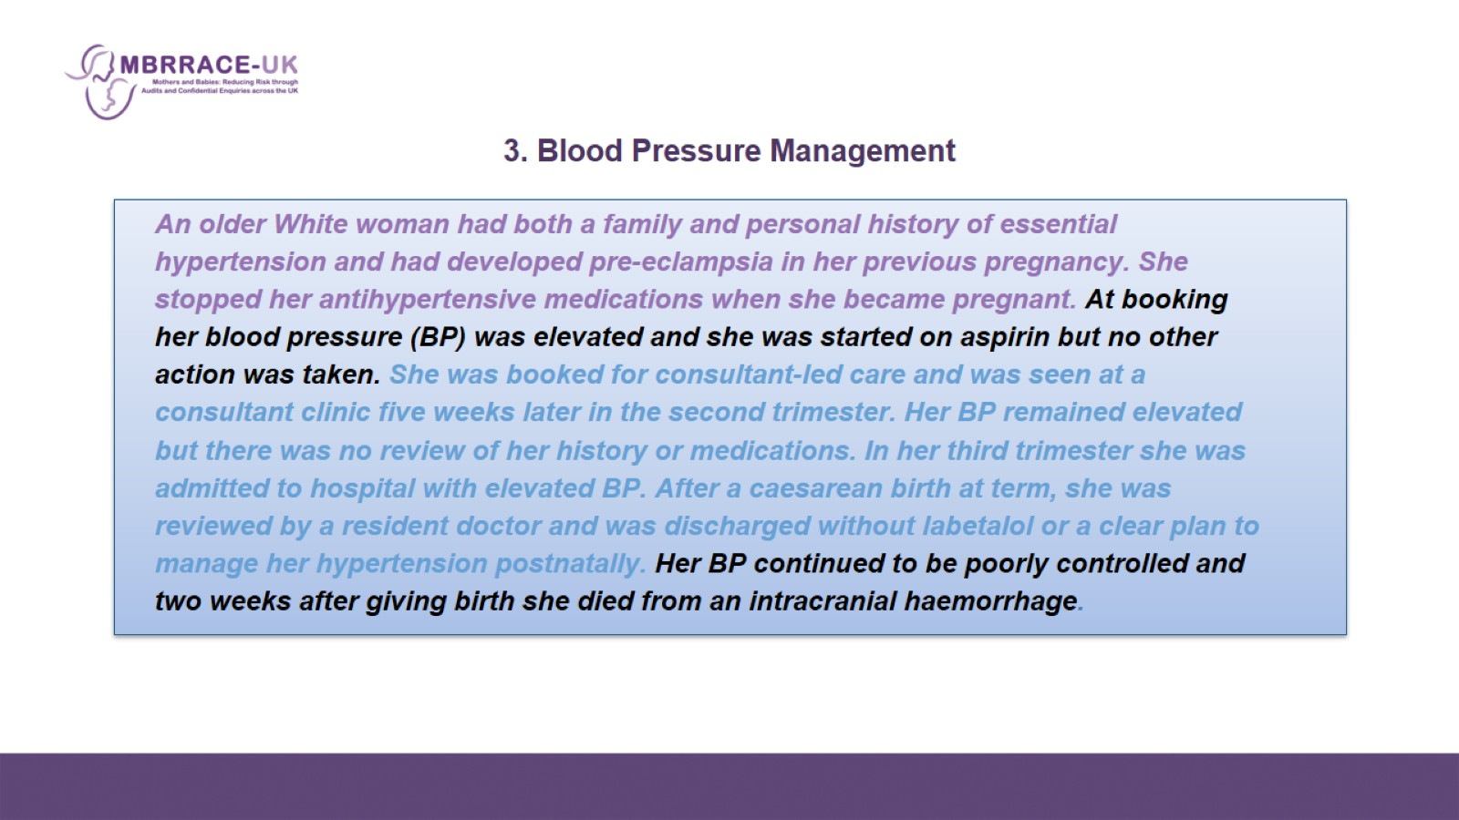
    3. Blood Pressure Management

Slide 11
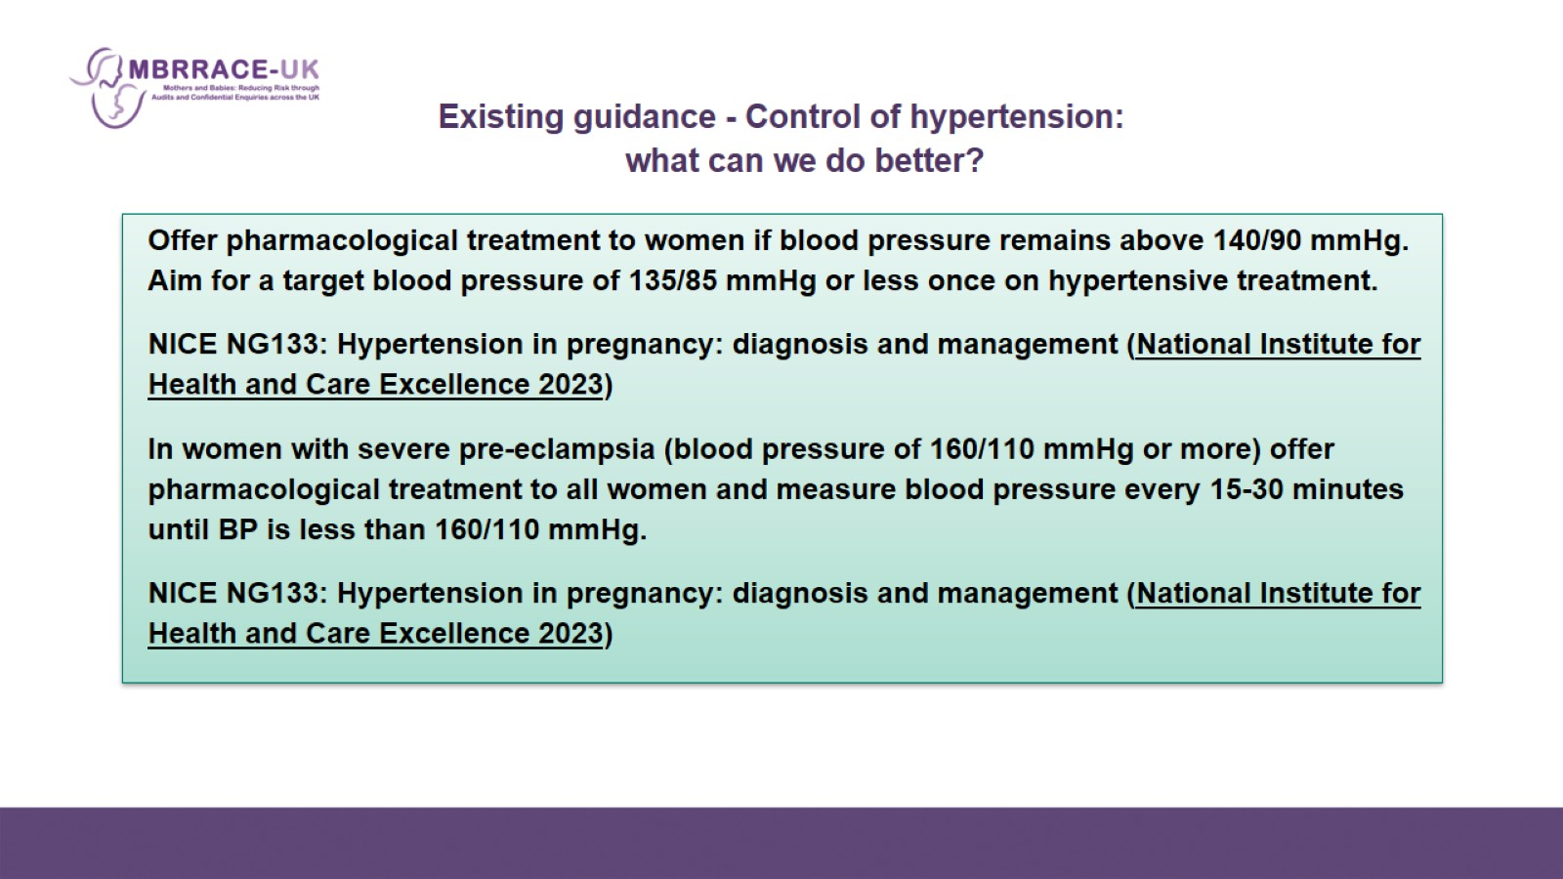
    Existing guidance - Control of hypertension: what can we do better?

Slide 12

    Education – women and professionals

Slide 13
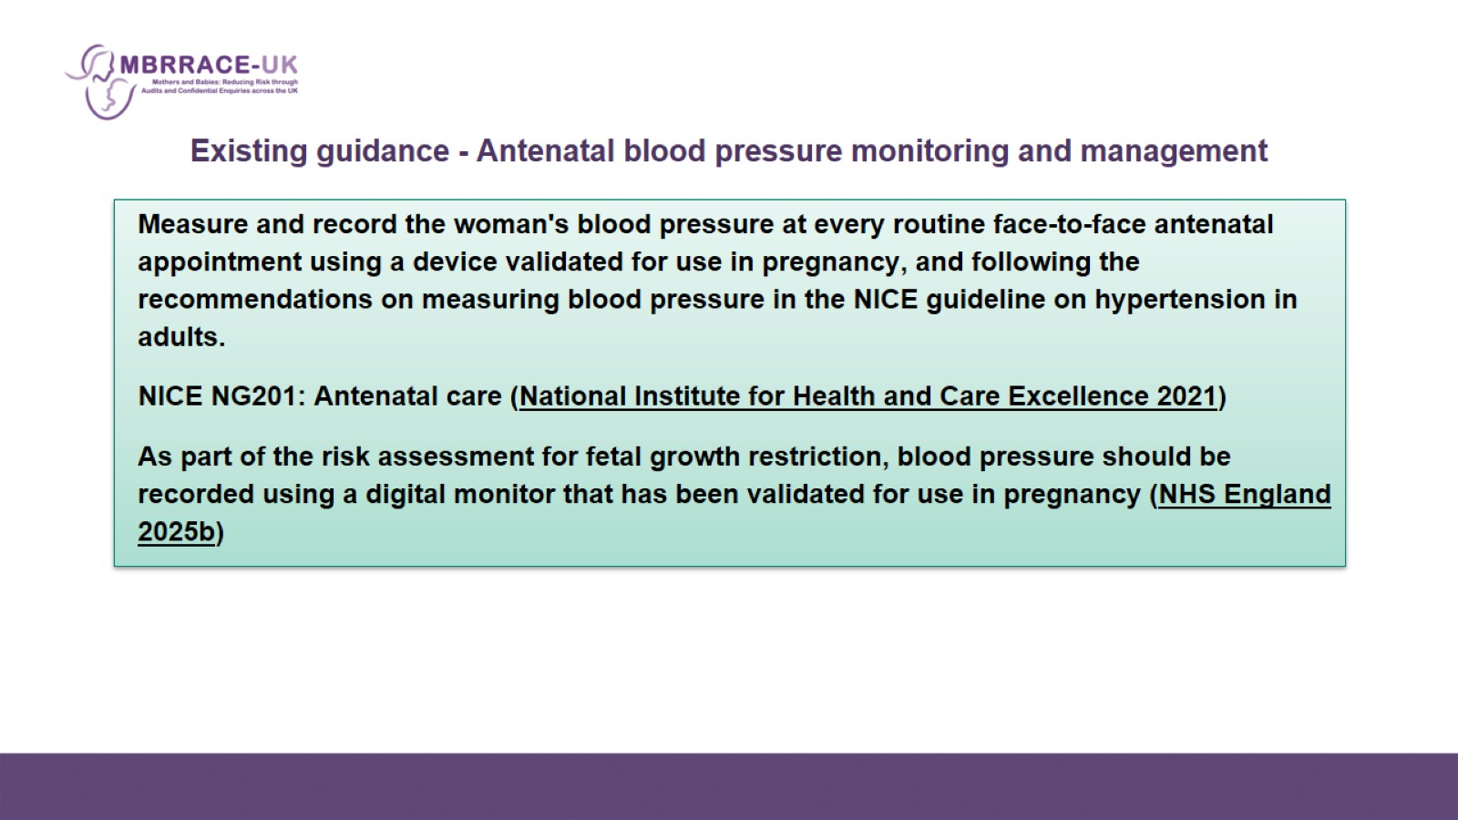
    Existing guidance - Antenatal blood pressure monitoring and management

Slide 14
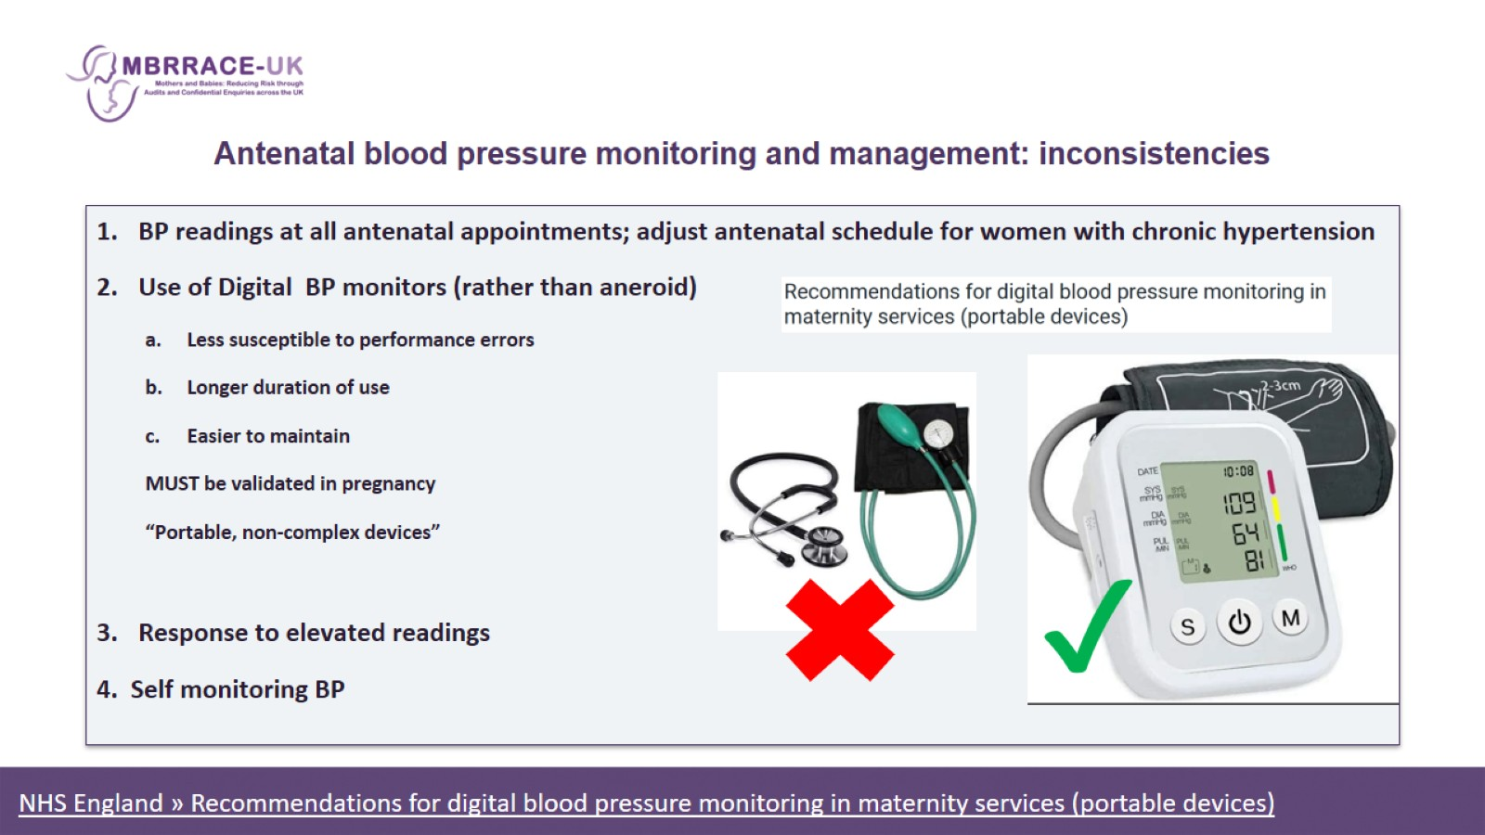
    Antenatal blood pressure monitoring and management: inconsistencies

Slide 15
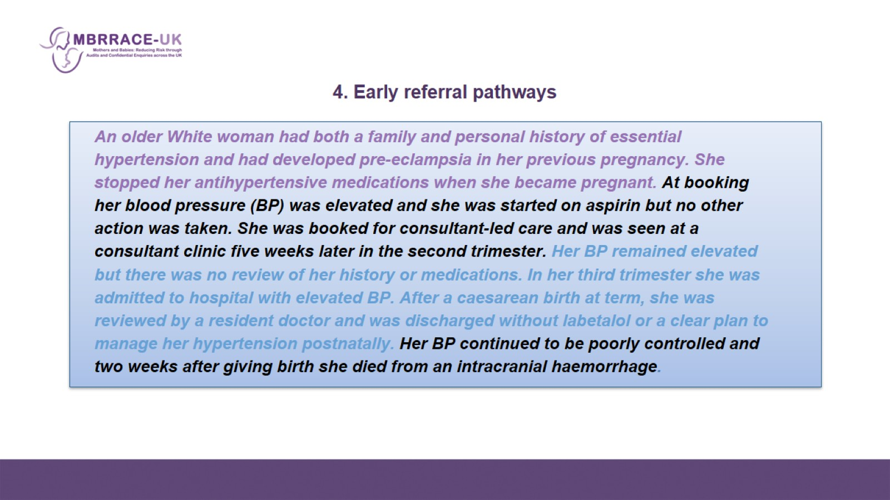
    4. Early referral pathways

Slide 16
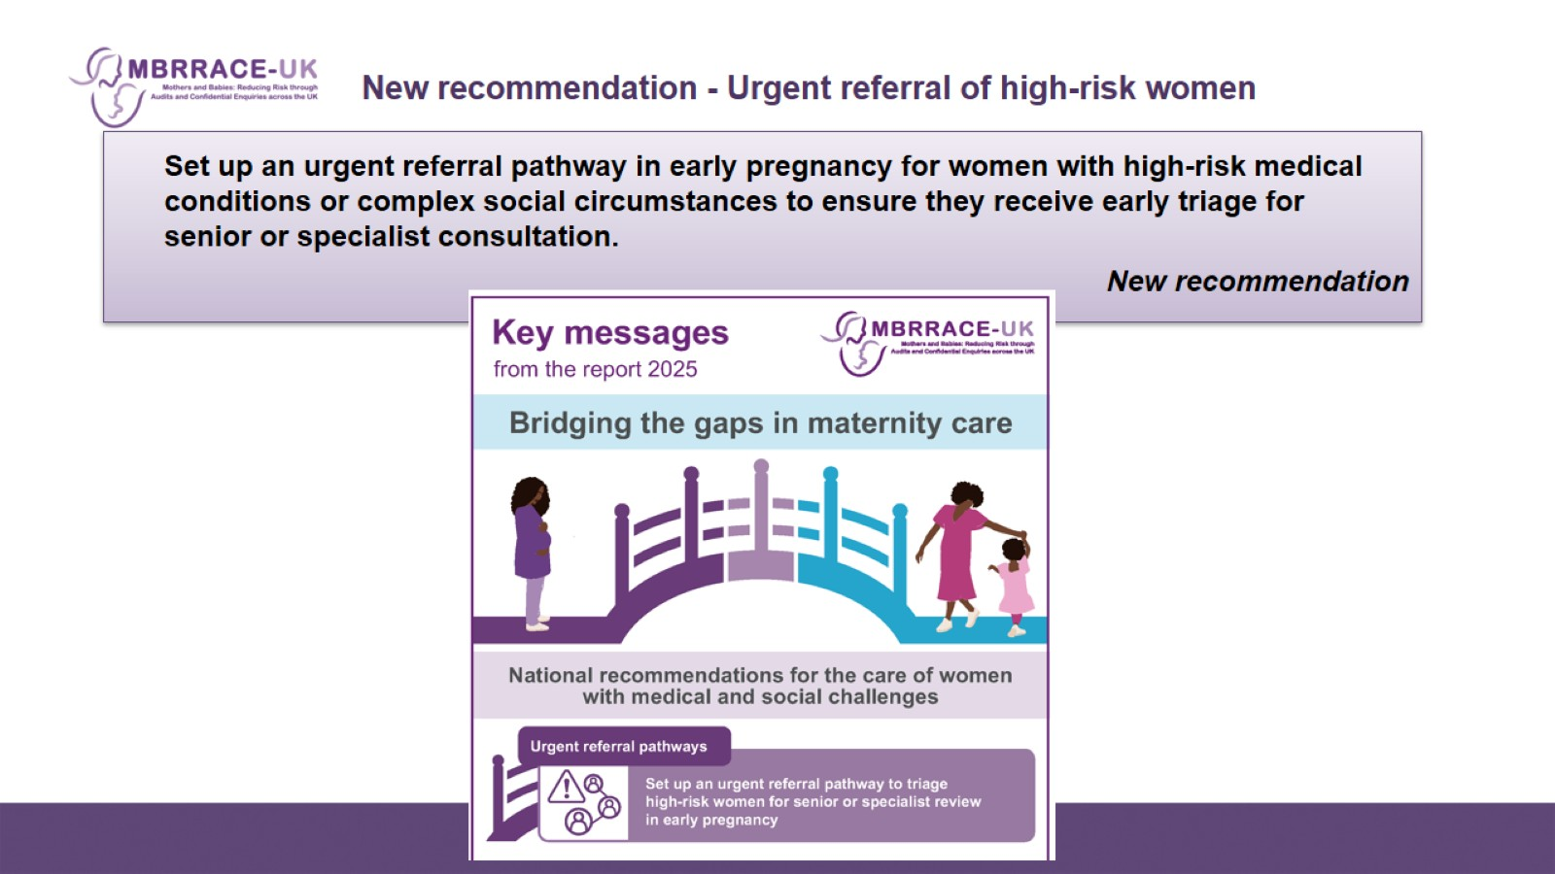
    New recommendation - Urgent referral of high-risk women

Slide 17
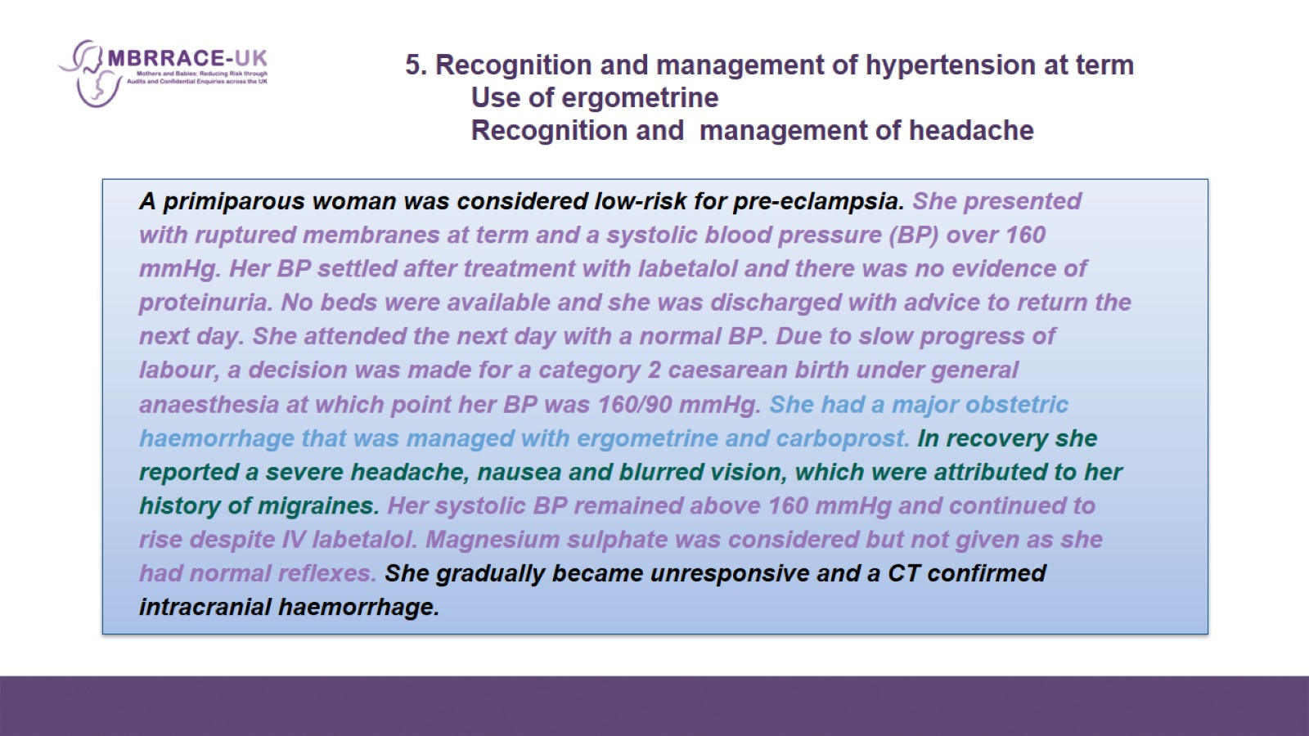

Slide 18
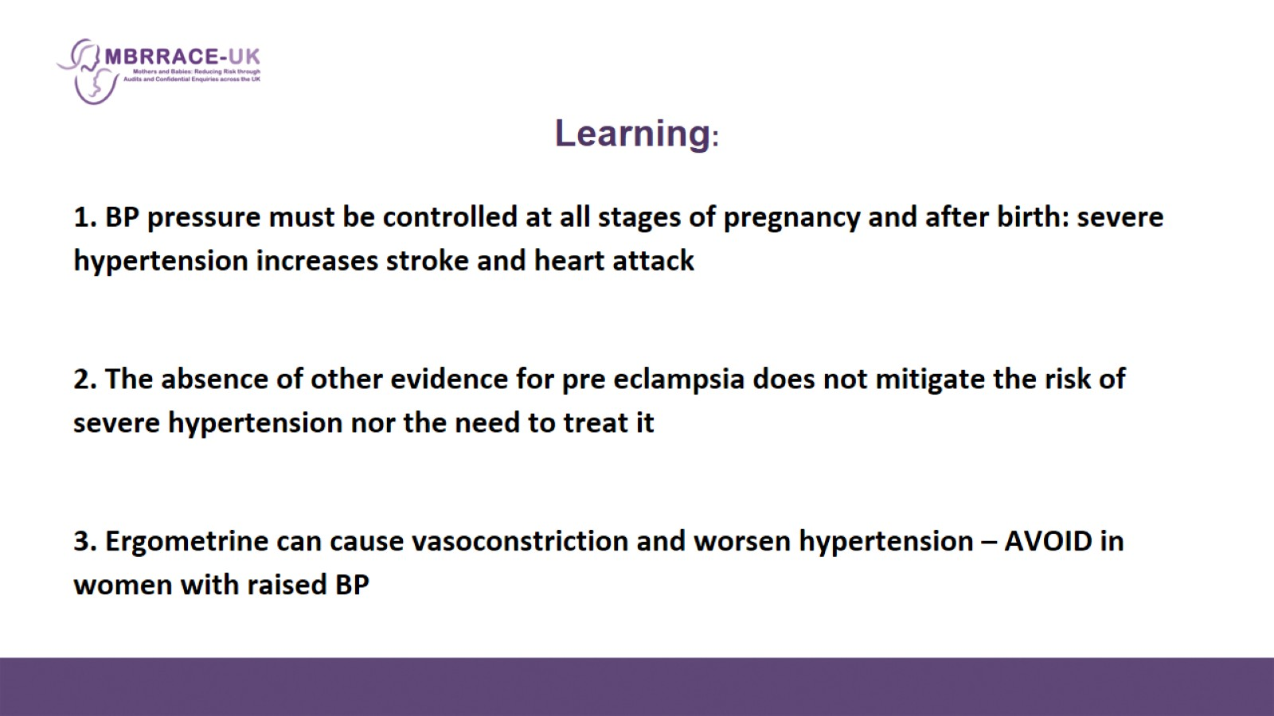
    Learning:

Slide 19
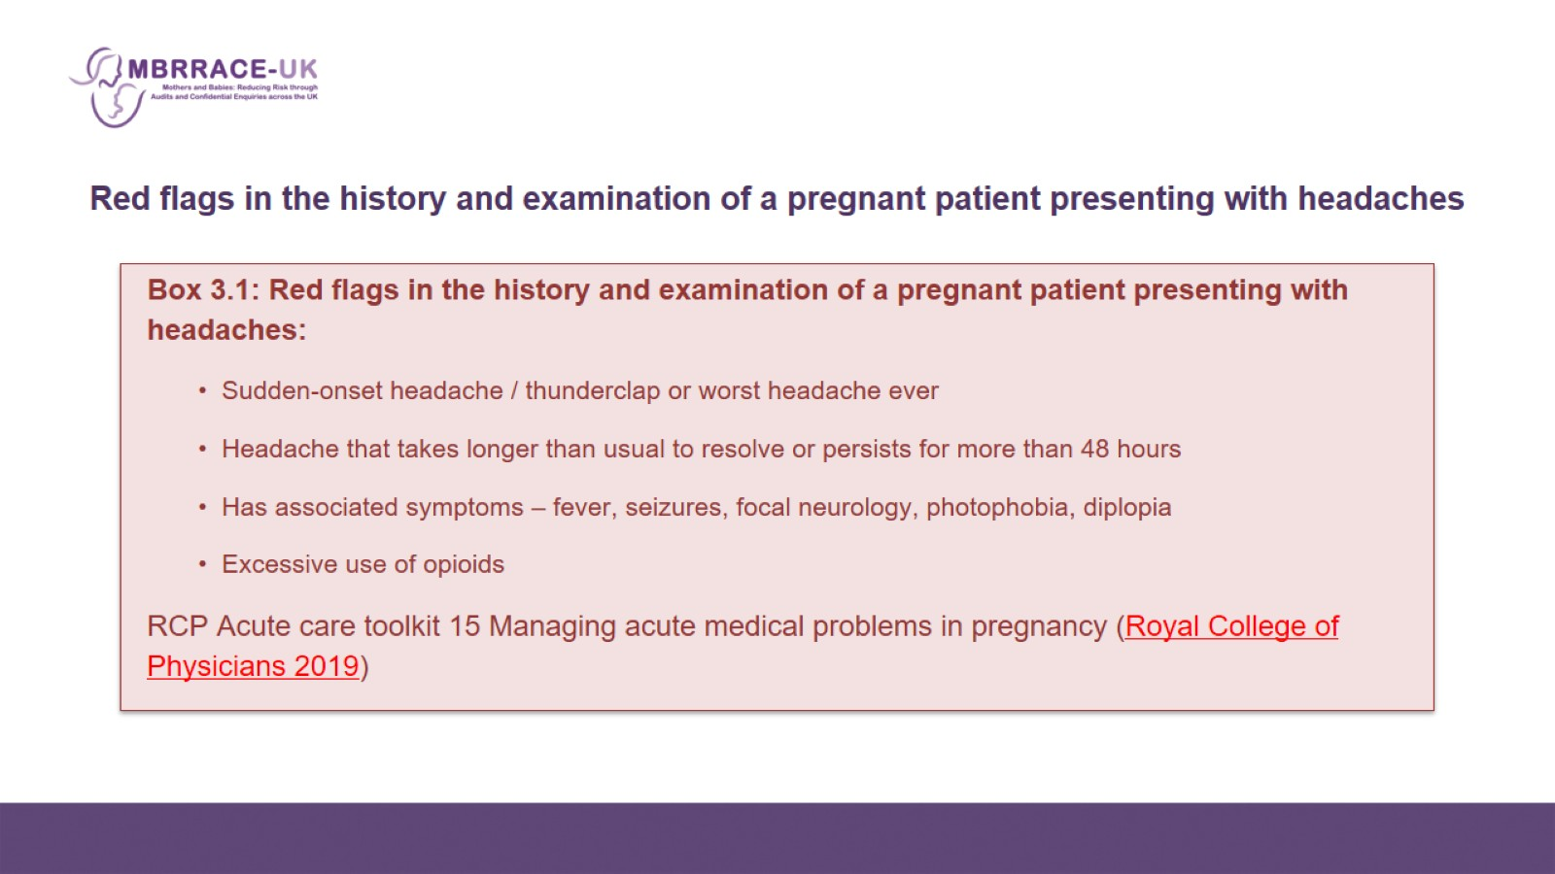
    Red flags in the history and examination of a pregnant patient presenting with headaches

Slide 20
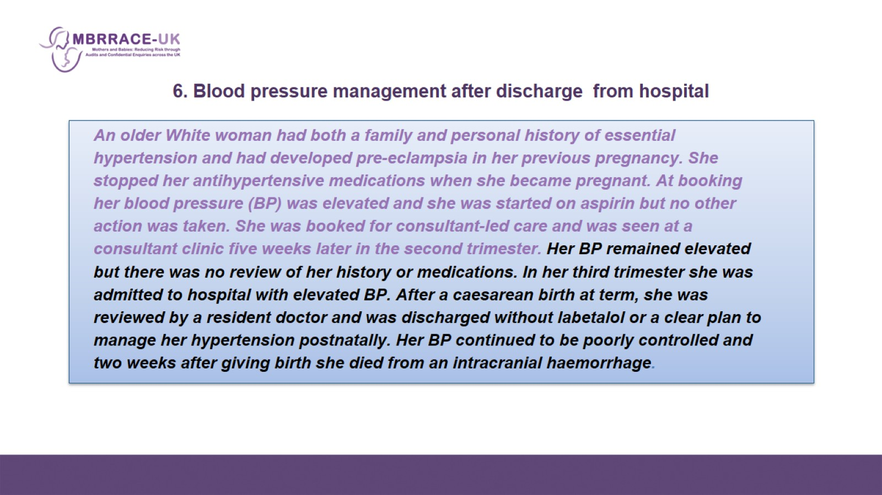
    6. Blood pressure management after discharge from hospital

Slide 21
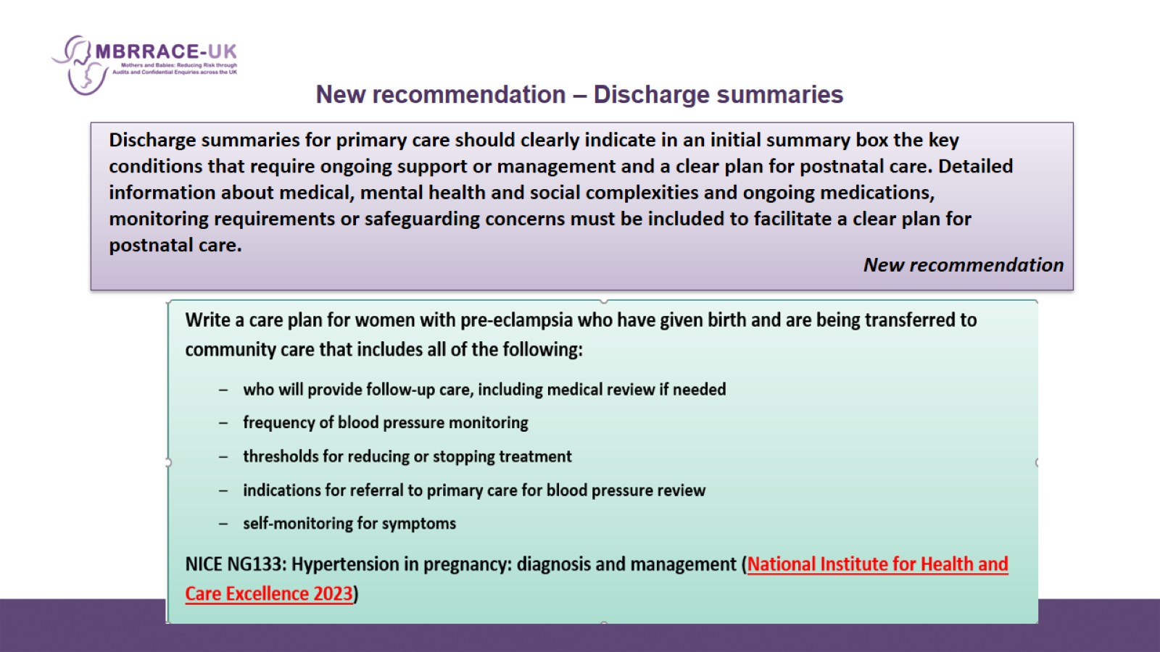
New recommendation – Discharge summaries

Slide 22
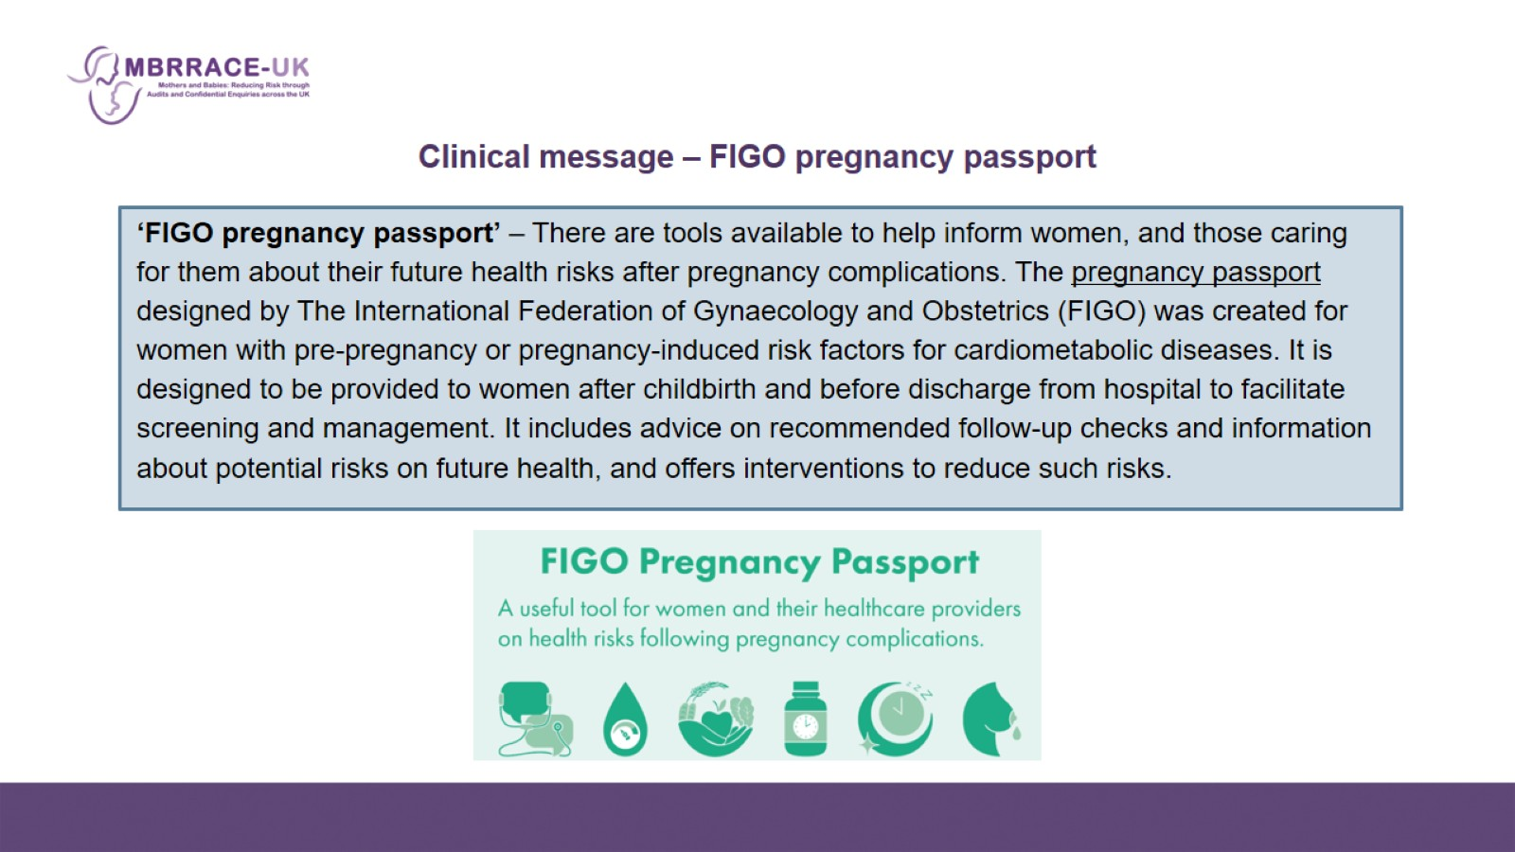
    Clinical message – FIGO pregnancy passport

Slide 23
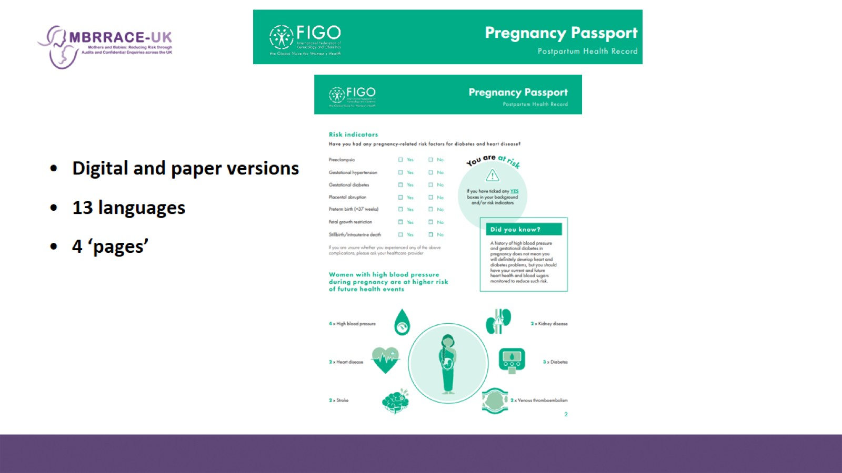

Slide 24
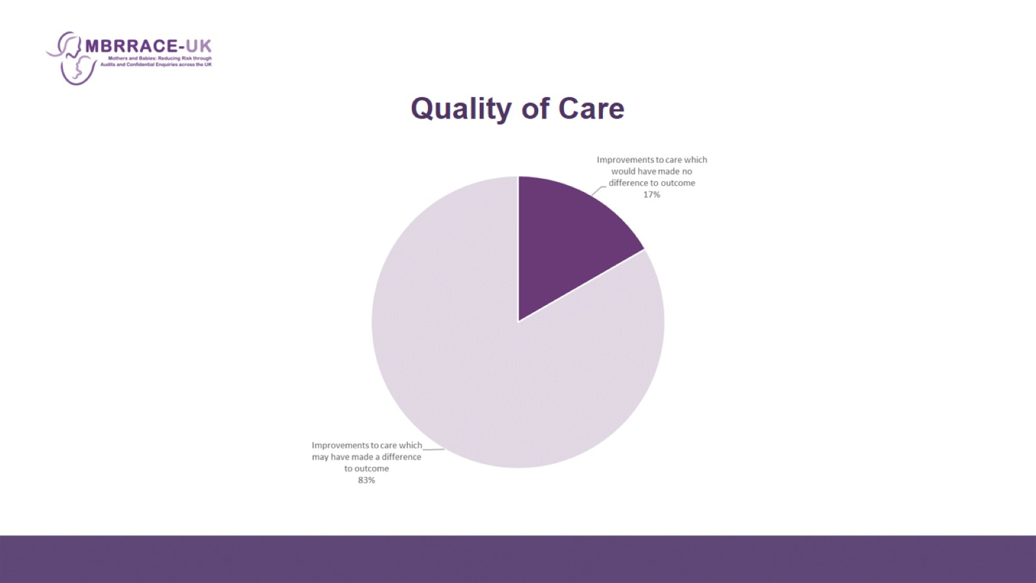
    Quality of Care

